Slide 1
Employee Data Analysis using Excel
STUDENT NAME : PRIYANGA S
REGISTER NO :312209123/322379B12A2A83D94454D6F97BB4ED87
DEPARTMENT :B.COM(A&F)
COLLEGE :ANNA ADARSH COLLEGE FOR WOMEN

Slide 2
PROJECT TITLE:
Employee data analysis using excel with pivot table and chart.

Slide 3


AGENDA:
Problem Statement
Project Overview
End Users
Our Solution and Proposition
Dataset Description
Modelling Approach
Results and Discussion
Conclusion
3/21/2024 Annual Review

Slide 4

PROBLEM STATEMENT:
4
IN EMPLOYEE DATASET,HOW WILL I COUNT THE HOW MANY MALE ,FEMALE AND GENDER NOT MENTIONED THERE IN THE DATASET?
HOW WILL I SEE HOW MANY EMPLOYEES ARE WORKING IN PARTICULAR LOCATION?
WHAT IS THE TOTAL SUM AND AVERAGE OF THE SALARY?
HOW MANY EMPLOYEES ARE PERMANENT,TEMPORARY AND FIXED TERM?
HOW WILL I GET PARTICULAR DATA IN EXCEL?
CAN I PROTECT MY SHEET AND WORKBOOK IN EXCEL?

Slide 5

PROJECT OVERVIEW:
IN THIS EXCEL,WE ARE GOING TO LEARN ABOUT HOW TO DO:
CONDITIONAL FORMATTING,
FORMULAS,
PIVOT TABLE,
PIVOT CHART,
MERGE AND CENTER ALIGN,
SLICER,
HOW TO PROTECT THE SHEET AND WORKBOOK.

Slide 6

WHO ARE THE END USERS?
IT WILL BE BENEFIT FOR MANAGER,EMPLOYEES,EMPLOYER,ORANGANISATION,IT SECTORS,INDUSTRY SECTOR,ETC.
IN THE ORANGANISATION WHERE HIERARCHY WILL BE BENEFITED WITH THIS DATASET

Slide 7

OUR SOLUTION AND ITS VALUE PROPOSITION:
CONDITIONAL FORMATTING IS USED TO FIND THE MISSING VALUES,IDENTIFICATION OF PERMANENT ,FIXED TERM AND TEMPORARY, IDENTIFICATION OF MALE AND FEMALE,AND LASTLY USED TO INDENTIFY THE VALUES IN START DATE.
PIVOT TABLE-DEPARTMENT,GENDER,EMPLOYEE TYPE,WORK LOCATION
SLICER-EMP.NO, NAME, SALARY, DEPARTMENT, EMPLOYEE TYPE,GENDER,WORK LOCATION
FORMULAS-SALARY,GENDER,EMPLOYEE TYPE

Slide 8
DATASET DESCRIPTION:
8
EMPLOYEE DATESET-EDUNET DASHBOARD
IN DATASET THERE ARE 9-FEATURES
BUT I USED ONLY 8-FEATURES
EMP ID-ALPHABET LETTER & NUMERIC
NAME-TEXT
GENDER-TEXT
DEPARTMENT TEXT
SALARY-NUMBERS
START DATE-DATES
EMPLOYEE TYPE-TEXT
WORK LOCATION-TEXT

Slide 9

THE "WOW" IN OUR SOLUTION:
9
EMPLOYEE TYPE:
=COUNTIF(DATA!H1:H196,RESULT!G5)
GENDER:
=COUNTIF(DATA!C2:C197,RESULT!G9)
SALARY:
=SUM(DATA!E2:E197)
=AVERAGE(DATA!E2:E197)
3/21/2024 Annual Review
9

Slide 10
MODELLING:
10
DATA COLLECTION:
The employee dataset is collected from EDUNET STUDENT DASHBOARD.
Naan mudalvan->student login->mandatory course->data analytics with excel->watch->access course->student dashboard->employee dataset.
FEATURE COLLECTION:
In dataset there are 9-features.But i used only 8-features:Emp id-alphabet letter & numeric,Name-text,Gender-text,Department text,Salary-numbers,Start date-dates, Employee type-text, Work location-text.
CONDITIONAL FORMATTING:
Conditional formatting is used to find the missing values in salary, identification of permanent ,fixed term and temporary in employee type, identification of male and female in gender, and lastly used to identify the values in start date.
SLICER:
Select the data from dataset->go to insert->slicer. Get the slicer for emp id, name, gender, department, salary, employee type, work location.

Slide 11
FORMULAS:
For salary , I used SUM and AVERAGE function.
For employee type, I used COUNTIF function to count the permanent, temporary and fixed term.
For gender, I used COUNTIF function to count the Male ,Female and Gender not mentioned.
PIVOT TABLE AND CHARTS:
I used pivot table and pivot chart for gender,department,work location, and employee type.
Select the data->insert->pivot table and chart.
PROTECT SHEET AND WORKSHEET:
Go to Review->protect sheet->enter the password->confirm the password.
To protect the worksheet= go to review->protect worksheet->enter the password.
To lock your file so that other users can’t open it.
To prevent users from adding, modifying, moving, copying, or hiding/unhiding sheets within a workbook.

Slide 12
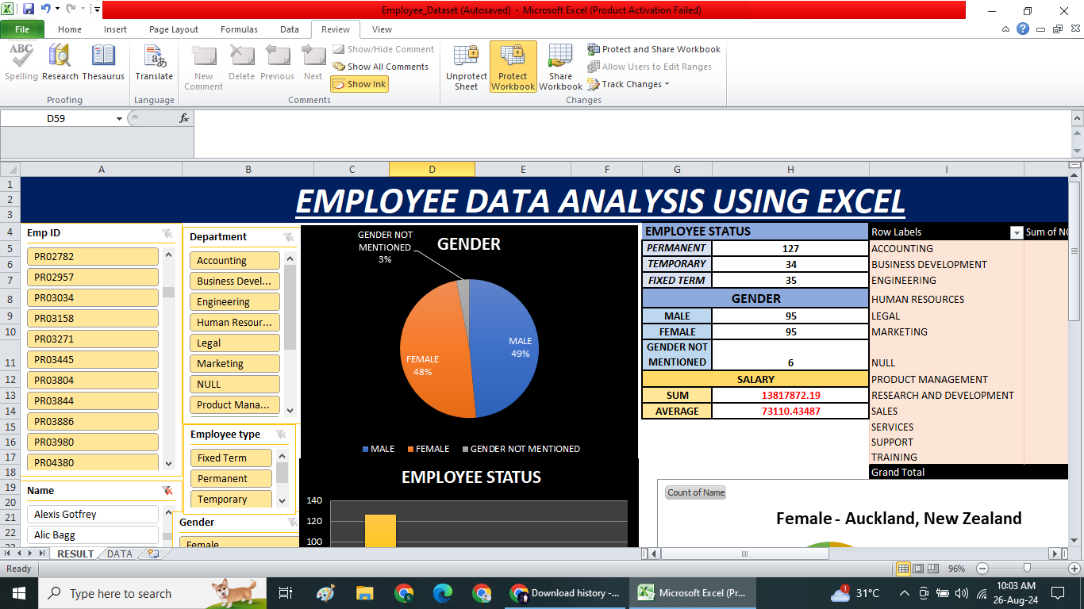
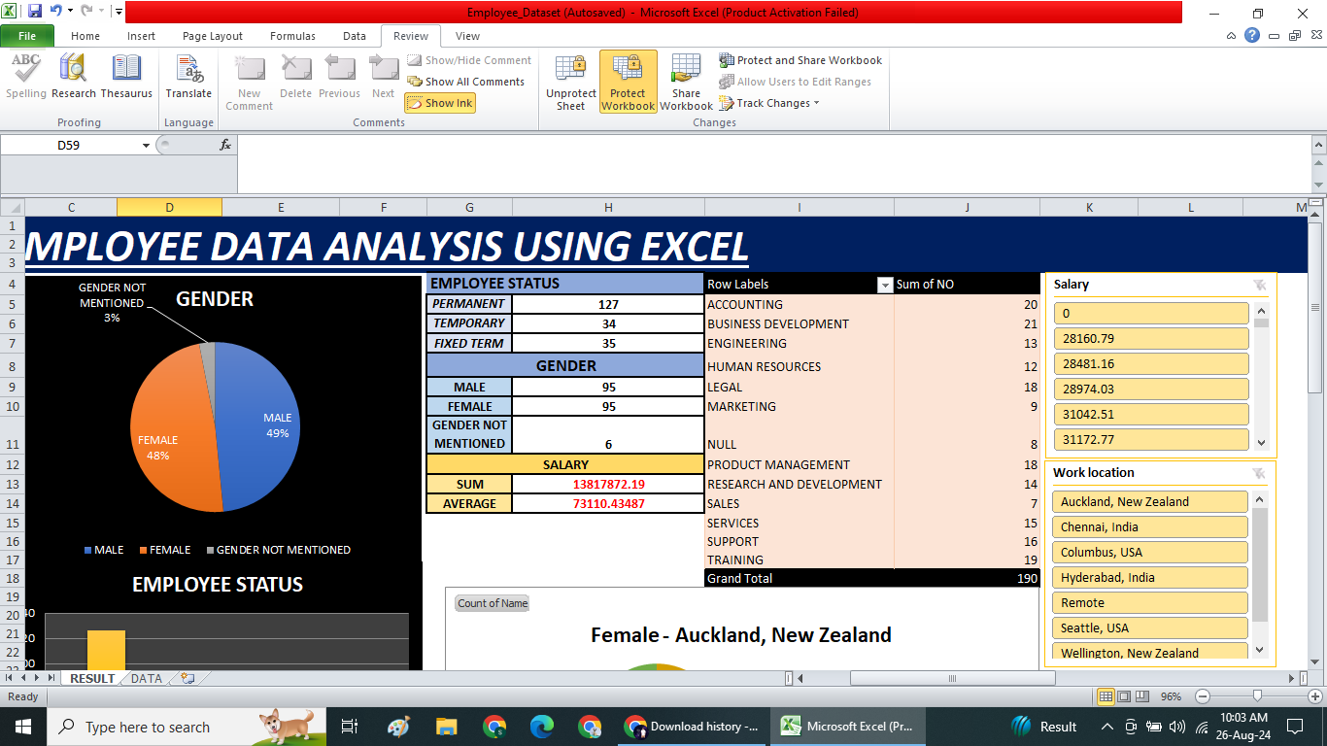
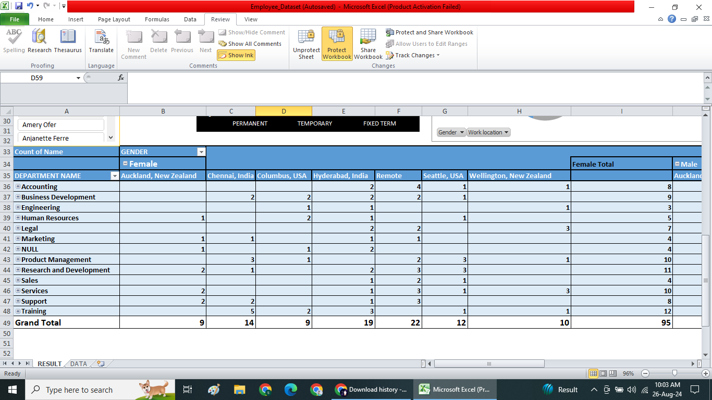
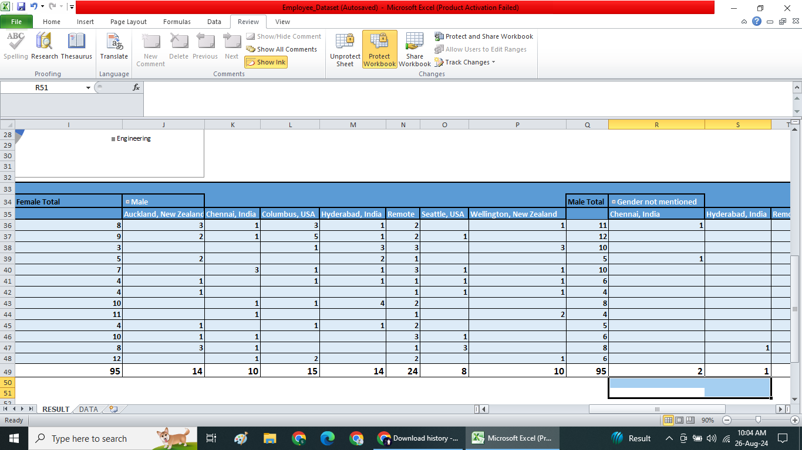
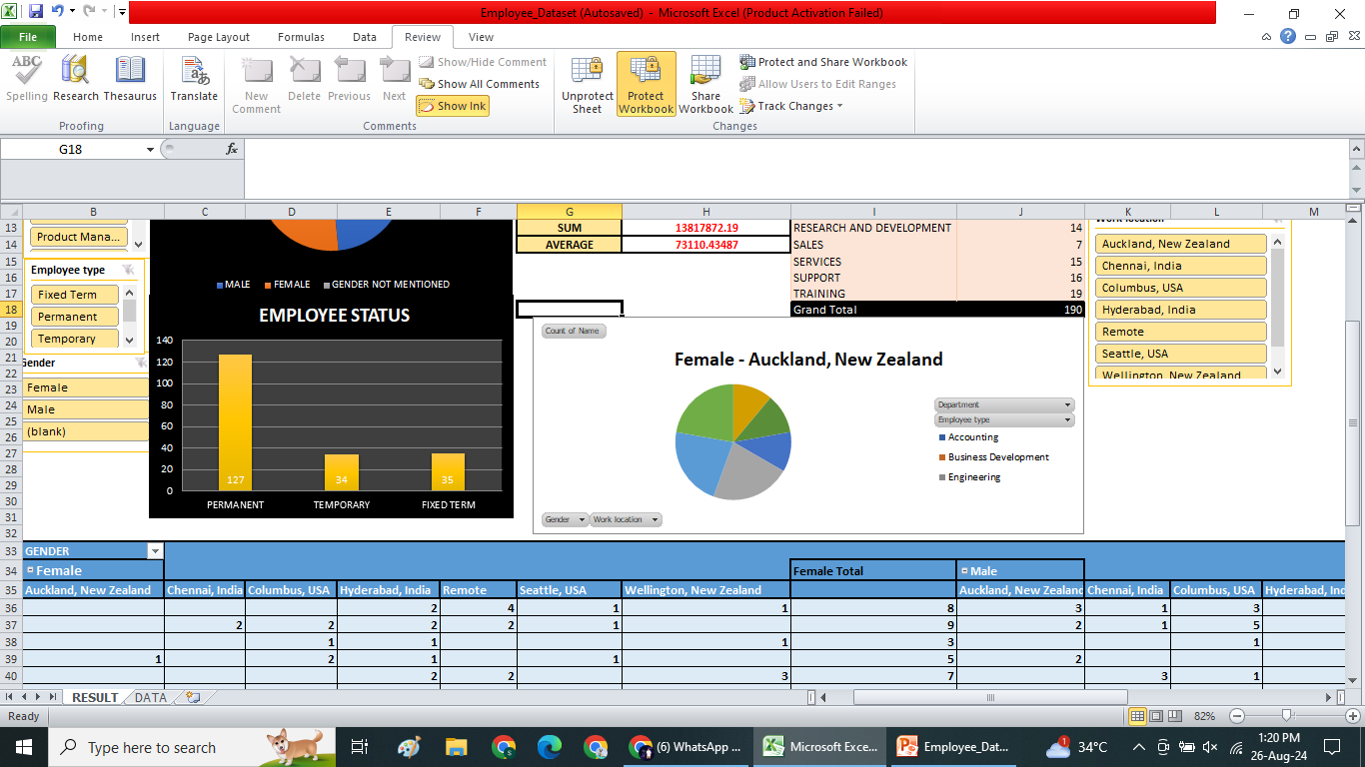
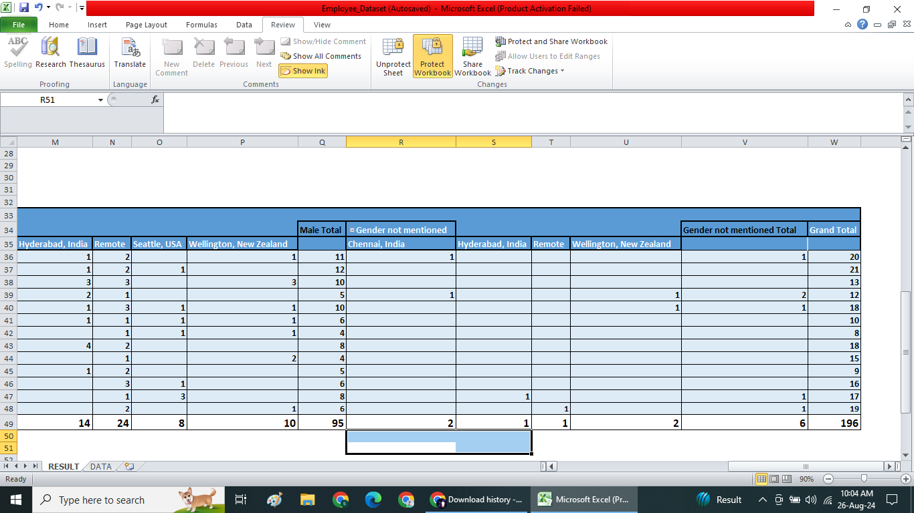
RESULTS:
12
12

Slide 13
Conclusion:
13
In conclusion, we can able to protect the sheet and workbook, so others cannot able to access or modify or change the data .
In this dataset,
Female-48%,
Male-49% and
Gender not mentioned-3%.
Permanent employees are higher than the fixed term and temporary.
127 employees are permanent.
34 employees are temporary.
35 employees are fixed term.

